Slide 1
MCA16 Professional Communication and Ethics
Dr. Ajitha.S
Associate Professor
Department of MCA
M S Ramaiah Institute of Technology

Slide 2
Formal Presentations

Slide 3
Agenda
Planning
Outlining and Structuring
Modes of delivery
Effective delivery
Body language and voice
Controlling nervousness
Visual aids

Slide 4
Objective
Importance of face –to-face presentation
How to be clear with your purpose in your presentation
How to plan ,structure, begin, develop, end and use effective body language
How to handle questions and criticism
How to control nervousness and stage fright while making a presentation
How to use MS power point to create impressive presentations

Slide 5
Planning
Occasion : Venue, location, equipment, time, events surrounding the presentation
Audience : interests, familiarity with topic, attitude, number, age, gender distribution
Purpose : inform, analyse, persuade
Amount of audience interaction
Persuade – people to take a particular action

Slide 6
Planning
Thesis statement: subject / central idea / topic
Choosing a reputed university for higher education
Why should we be careful in choosing a reputed university? (question)
Choosing a reputed university for higher education (fragment)
Choosing a reputed university for higher education has five significant advantages
The steps to arrive at your thesis statement:
Topic: Choosing a reputed university for higher education
Topic area: Advantages of a reputed university
General purpose: To inform
Specific purpose: I wish to tell my audience about the benefits they will reap by choosing a reputed university
Thesis statement: Choosing a reputed university for higher education has five significant advantages.

Slide 7
Planning
Material : supporting ideas ( library, internet, magazines, newspapers, records, statistics)
Surveys or interviews

Slide 8
Outlining and Structuring
Outline : framework to fit in bits and pieces of information
Gives you a sense of direction / roadmap
Have main topics and appropriate subtopics
Structure : Introduction, Main Body, Conclusion, Question-Answer

Slide 9
Introduction
Greeting (reference to the day)
Attention grabber (use question, quotation, starting statement, etc)
Topic, purpose
Credibility
Preview
Rules for question-answer session
Transition
Similar to the preface of a book—gets attention and arouse their interest to listen further
Topic – Applications of IoT and Advantages

Slide 10
Main Body
Organizational patterns:
Chronological – in the order in which the events occurred or appeared before us
Categorical – divided into topics and subtopics
Cause and effect – whenever a cause and effect relationship
problem-solution – divided into two parts:
first part describe and analyse the problem
second part propose a solution to the problem

Slide 11
Main Body
Supporting material: clarifies the main idea, makes it more vivid and meaningful, helps establish the main statement
Definition
Examples
Statistics
Analogy
Testimony

Slide 12
Conclusion
Last opportunity to impress upon your audience
Give a signal ( to sum up, to conclude, change in tone)
Recall the purpose of presentation
End with a bang not with a whimper
Can use an apt quotation, joke, anecdote, etc.
Refer to the introduction

Slide 13
NUANCES OF DELIVERY
‘Bad presentations’ ‘smooth presentations’ which will put the audience to sleep
To be delivered effectively and efficiently to capture the audience’s attention
Reveal enthusiasm to the audience
Address their questions or objections directly

Slide 14
Modes of delivery
How to hold the attention and interest of the audience?
Part of an expert delivery
Manner of presentation, vocal inflections, perfectly timed pauses, facial expressions, and gestures
combine a certain degree of formality with the best attributes of good conversation—directness, spontaneity, animation, vocal and facial expressiveness—and a lively sense of communication
Having something to say is not enough; you must also know how to say it

Slide 15
Modes of delivery
Extemporaneous
Manuscript
Impromptu
Memory

Slide 16
Modes of delivery
Extemporaneous : Presenting with points
Best, good eye contact, freedom to the speaker, natural and spontaneous ( but to be prepared well)
Advantages
The theme can be presented in the best possible structured way
makes us feel secure and we carry out our responsibility with self-confidence and assurance
Supporting material helps to present our points clearly and also adds weight to our agreement
sounds natural and spontaneous
more eye contact
Disadvantages
If preparation is inadequate, we can get lost and find ourselves uncomfortable.
If reading out from note cards then the speech will lose its spontaneity

Slide 17
Modes of delivery
Manuscript : Reading the text
should know what is written where
Advantages
It is a permanent and accurate record of whatever we have to say
There is no chance of tampering with the facts and figures.
The material is organized systematically.
Language gets polished because we can write and rewrite our material
Disadvantages
less time for making proper eye contact
we cannot talk to them. There is not much scope either for non-verbal communication.
Can’t be changed
In the absence of effective reading skill, we fumble over words, lose our pace, and miss punctuation marks, etc.
Conversational flavor along with vocal inflection takes a back seat
used by top leaders to avoid misunderstanding

Slide 18
Modes of delivery
Impromptu: Presenting without prior preparation (Informal speech)
keep brief, cover two or three points
Advantages
We sound very natural
We get a chance to express our thoughts irrespective of what others think or say about that particular topic.
We are spontaneous as we say what we feel, not what we ought to say.
Disadvantages
Lacks organized development of ideas because of the shortage of time.
No supplementary material (no data, no statistics, no illustrations, no figures) to substantiate the speech.
Chances of rambling are very high. Various points may hang loose.
There is frequent use of vocalized pauses.
The presentation may turn out to be a failure if the speaker has inadequate proficiency in the language he/she uses.

Slide 19
Modes of delivery
Memory:
Speech is written out beforehand, then committed to memory, and delivered from memory
Advantages
can maintain an eye contact with the audience throughout the presentation.
can easily move and make use of appropriate non-verbal communication to add extra value to the speech.
possible to finish the speech in allotted time.
Disadvantages
Memorization requires too much of time.
chances of making it a dull and monotonous presentation
may fail if we have not rehearsed adequately
No flexibility or adaptation is possible during the speech.
The speaker gets flustered if he/she forgets a word, sentence, or a whole paragraph.

Slide 20
Guidelines for effective delivery
Success of any presentation also depends on the various elements used during a presentation
Verbal
Non-verbal (body language)
Vocal and
Visual

Slide 21
Guidelines for effective delivery
Verbal elements:
word picture
warm words
similes and metaphors
impact words
smooth flow

Slide 22

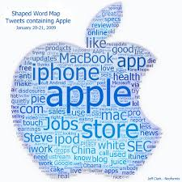

Guidelines for effective delivery
Verbal elements: word picture

Slide 23
Guidelines for effective delivery
Verbal elements: Warm words
Cold words leave us uneasy and unsure while warm words make us feel secure and comfortable.
Advertisement for instant coffee
‘quick’, ‘time-saving’, and ‘efficient’
‘aroma’, ‘fresh’, and ‘tasty’
‘delicious’, ‘rich’, and ‘satisfying’

Slide 24


Effective delivery
A figure of speech involving the comparison of one thing with another thing of a different kind

Slide 25
Guidelines for effective delivery
Verbal elements: Impact words
‘We’ and ‘you’ are the most important words of all
Remember the five to-one rule: Every time you use the singular ‘I’, try to follow it with five plurals
discovery, guarantee, love, proven, safely, easy, health, vigor, money, results, save, protect, interest, challenge, opportunity, excitement, enthusiasm, flourish, progress, favorable, adaptation, circumstances

Slide 26
Guidelines for effective delivery
Smooth Flow : can make our speech flow smoothly and gracefully from beginning to end by using some transitional devices.
Bridge, Number item, Trigger, Interjection, Internal summary, Internal preview, Signpost, Rhetorical question, Flashback, List, Pasue, physical movements, Quotations, anecdotes and jokes.

Slide 27
Effective delivery
Nonverbal elements : appearance, posture, gesture, eye contact, facial expressions
Vocal elements: Paralinguistic features / voice
Visual elements: visual aids / graphics/ pp slides

Slide 28
Effective delivery
Nonverbal elements : appearance, posture, gesture, eye contact, facial expressions effectively during your presentation.
Wear a formal dress and use simple accessories; take care of your personal hygiene
Use facial expressions to exhibit your enthusiasm and interest; do not show your irritation or anger even when someone interrupts you or asks a question that appears to be silly to you; be polite in answering them
Make eye contact with all sections of the audience (avoid staring at somebody) to observe their reactions and also to show your sincerity and interest
Use well-timed gestures; avoid monotonous gestures
Stand tall and straight with shoulders upright; walk/move swiftly; avoid too many and monotonous movements
Do not come very close to the audience; maintain a distance of at least 4–12 feet
While using blackboard, raise your voice and look at the audience in between
Avoid fiddling with key ring or tie while presenting
Avoid looking outside even if there is some external noise. Try to concentrate on your ideas and audience

Slide 29
Effective delivery
Vocal elements: Paralinguistic features / voice
Speak with enthusiasm and sincerity
Adjust the volume of your voice
Avoid monotonous or vocalized pauses
Use your optimal pitch
Avoid fast delivery
Use silence and pause effectively
Articulate each word clearly
Visual elements: visual aids / graphics/ ppt slides

Slide 30
Controlling nervousness
Strategies in advance of presentation
Develop interest in the topic
Prepare, prepare and prepare ( most important)
Anticipate questions and prepare answers
Practice introduction
Rehearse complete presentation at least twice
Strategies just before presentation
Be comfortable with the setting, arrangements, visual aids, etc.
Take few sips of tepid water
Concentrate on ideas
Relax by taking deep , even, slow breaths
Practice positive visualization
Strategies when presentation begins
Feel good
Do not begin immediately or hurry
Never comment on your nervousness
Control the explicit signals: dry mouth, clearing throat, etc.

Slide 31
Visual Aids
Overhead transparencies
Power Point Presentations
Black / White board
Flip Charts

Slide 32
Visual Aids
Application of MS Power point
Design, layout and colour
Font
Number of slides
Illustrations
Video or audio clips
Spacing in the slides
Slide show animations

Slide 33
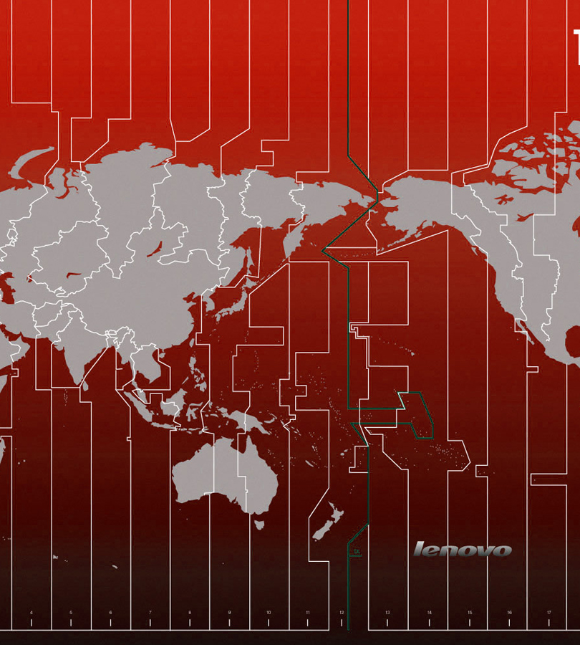
World Map
Map of the world gives geographical positons of countries

Slide 36
Any Questions

